Slide 1

CS Capstone Submission System
Skerdilajd Skenderi
CSC 521
Fall 2022
Supervisor: Dr. Hatfield

Slide 2
Table of Contents
Problem Specification
Implemented Features and Amendments
Design Diagrams
Tools Used
Postmortem
Delivered
Demo

Slide 3
Problem Specification
Motivation: Deficiency of the current computer science capstone submission process.
Deliverables are submitted on an individual basis
No centralized management
Easily forgotten or lost
No sharing provided between faculty
Solution:
CS Capstone Project Submission System
Three types of users: Student, Faculty and Administrator
Notes:
Initially Dr.Hatfield observed a deficiently in the submission and organization of capstone projects.
Way sumbissions are done in CS Department
This web application seeks to remedy that

Slide 4
Implemented Features AND Amendments
Capstone Project Submission System
The student can upload their submissions on the website
The student can validate their presence by previewing
The faculty member can view all folders/files related to the student that they advises
The faculty member can preview, and download files uploaded by the students
The faculty member can set the visibility of a file, this will affect the file’s visibility as it related to other faculty members
The administrator can add or remove both faculty or students from the system.
The administrator can add file requirements as well as disable retired requirements.
The administrator can archive all documents related to inactive users.
STUDENT
FACULTY
ADMINISTRATOR
Notes:
3 target users.
Secondly, the faculty,
Thirdly, the administrator

Slide 5
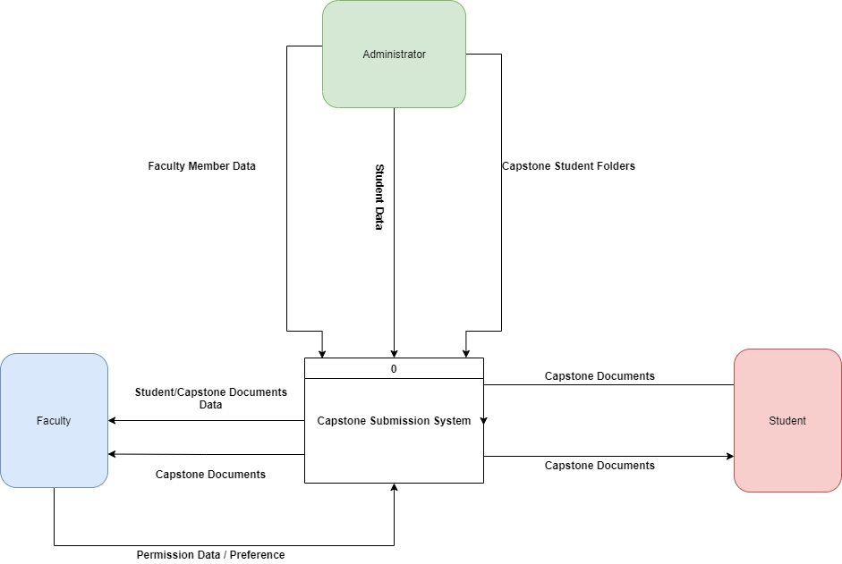
Design Diagrams System Context Diagram (SCD)

Slide 6
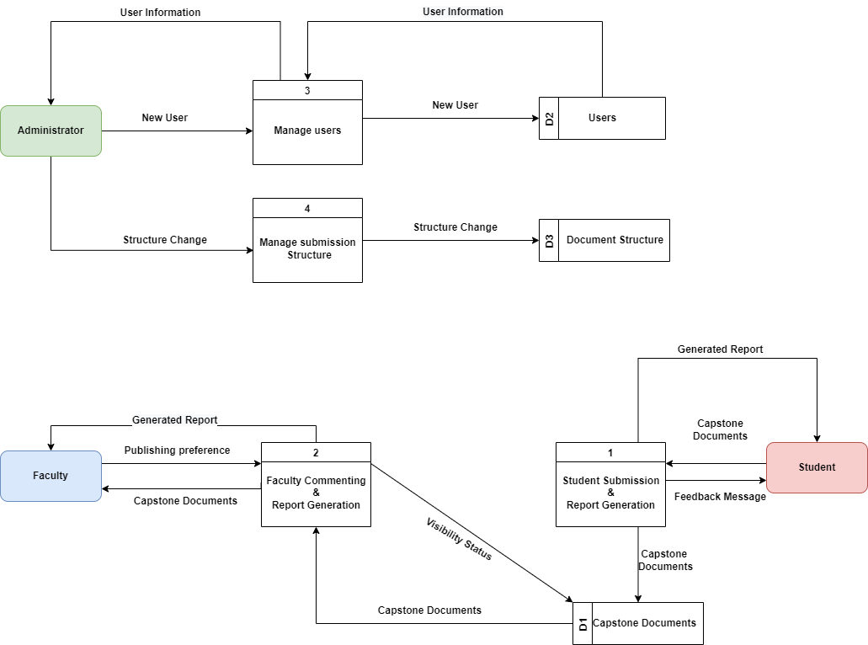
Design Diagrams Functional Decomposition Diagram (Level 0)

Slide 7
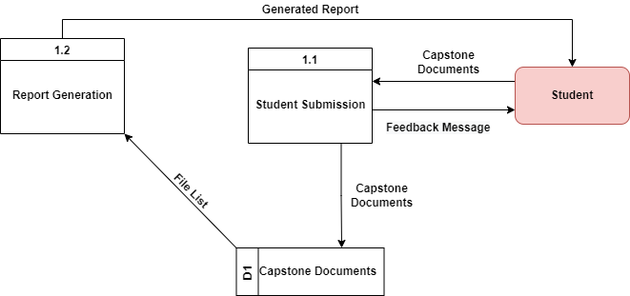
Design Diagrams Functional Decomposition Diagram (Level 1)

Slide 8
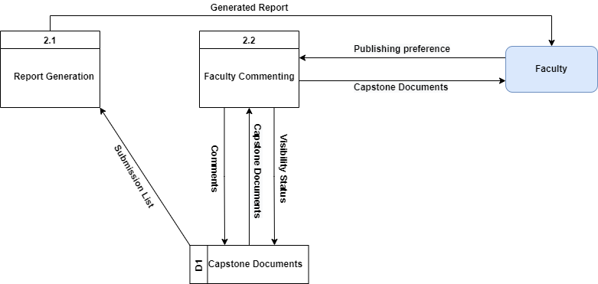
Design Diagrams Functional Decomposition Diagram (Level 1)

Slide 9
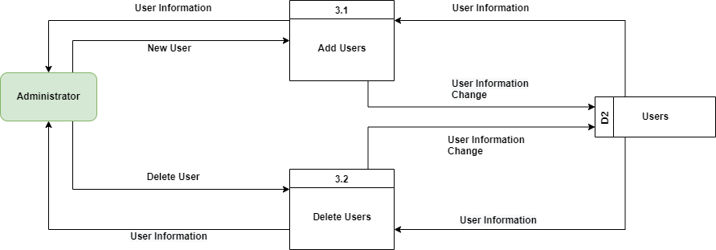
Design Diagrams Functional Decomposition Diagram (Level 1)

Slide 10
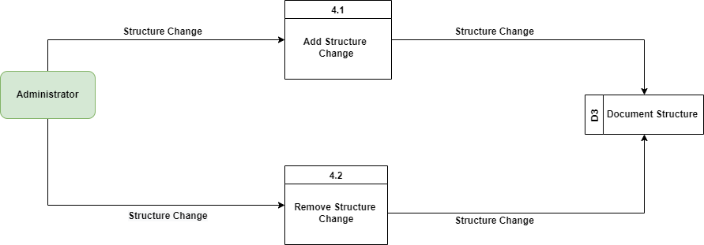
Design Diagrams Functional Decomposition Diagram (Level 1)

Slide 11
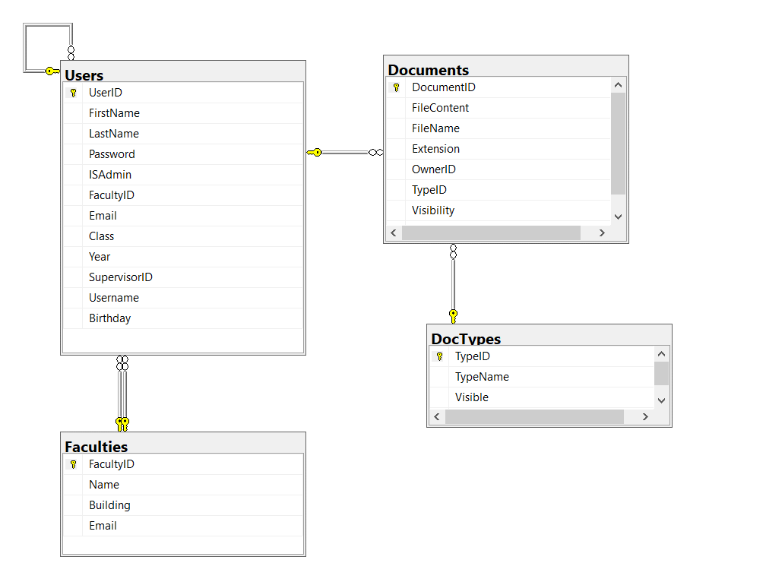
Design Diagrams Database Schema (MS SQL)
Notes:
Users and Faculties table = relationship between what faculty has who
Document and Doctypes = documents store file information and doctypes store information about sub requirements.

Slide 12
Tools Used
Languages
C#, HTML, CSS, JavaScript
Frameworks & Libraries
Bootstrap, .NET MVC
IDE
Visual Studio 2022
Database Management System
Microsoft SQL Server
Project Management
Trello
Version Control
Git / GitHub

Slide 13
Postmortem
Improved skills in the languages and frameworks (Javascript, .NET MVC, C# etc.)
Learned and gain further skills with a relational DBMS
Applied software development techniques to a real-world application
Notes:
DBMS helped reinforce what I had learned in class

Slide 14
DELIVERED
Original proposal and presentation file(s) (from CSC 520)
Final Report that contains:
Amendments to the proposal (approved by the CSC521 project supervisor)
System architecture diagram(s) (UML, DFD context, etc.), enhanced with details determined during implementation
Appropriately commented source code: GitHub repo URL
Documentation of project functionality (test results, screenshots, video capture of project execution, etc.)
Sample output (screen shots)
Executables and/or projects: Web Application URL
Project journal: a narrative of the progress of the project, in clear, concise English, including any problems encountered and how said problems were addressed
Project postmortem: a summary of what was learned from the project and (based on that experience) discussion of how various aspects of the project might have been approached differently
A list of what areas of the proposal (if any) were not completed, including reasons why
Presentation of the completed project (PowerPoint format), including demonstration of the functioning project

Slide 15
DEMO
I will now give a demonstration of the website.
Notes:
Add eye icon or “SHARED” next to the checkmark.
Getting rid of the red X Replace red X with No Submission or similar.
Figure out why that < icon is not display
Rpelace comments effectively all in English.
This user has no submissions.
Bug with user not displaying under faculty.

